Slide 1

CSCI 5502: DATA MINING Project Proposal
Stock Market Pattern Mining
Team Members:
Arnav Purushotham
Meghasrivardhan Pulakhandam
Sneha Nagaraju

Slide 2
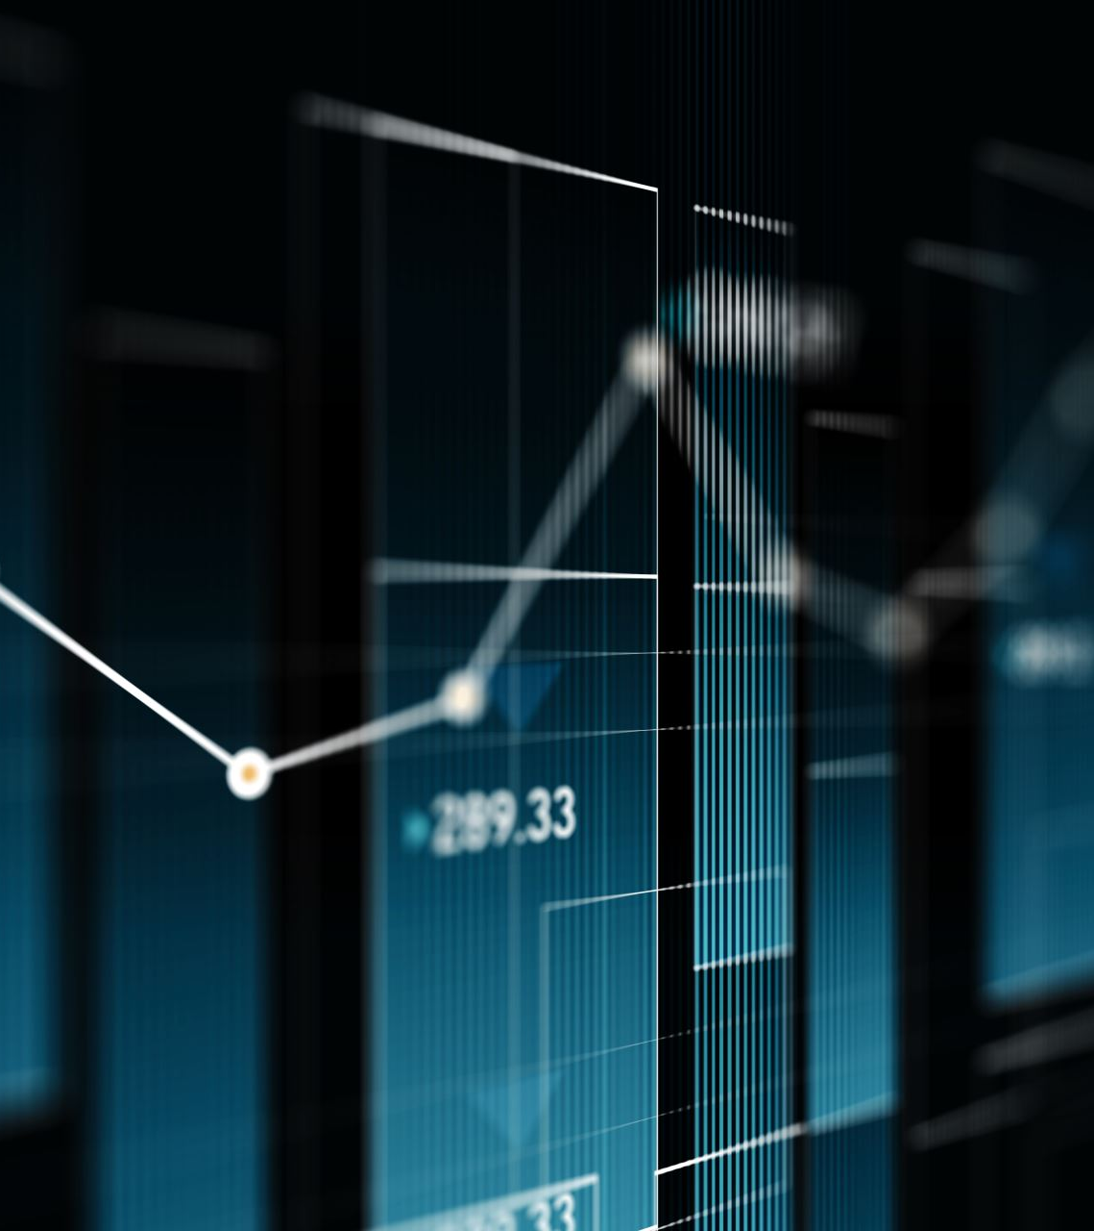
INTRODUCTION
Problem:
Stock data is vast, noisy, and hard to interpret.
It is difficult to identify useful patterns just by observing price data.
Agenda:
Train an ML model on past stock data.
Use live prices from FinnHub API for real-time inference.
Add latest analysis and news through GPT-4 API.
Aggregate both signals for a final prediction.
Our Goal:
Provide a more complete, real-time analysis rather than just raw predictions.
Why:
Check if patterns can help predict short-term movements using Machine Learning.

Slide 3
RELATED WORK
Many studies use past stock data for simple predictions.
Common method: Moving averages, RSI and other indicators.
Some advanced models exist, but often too complex.

Slide 4
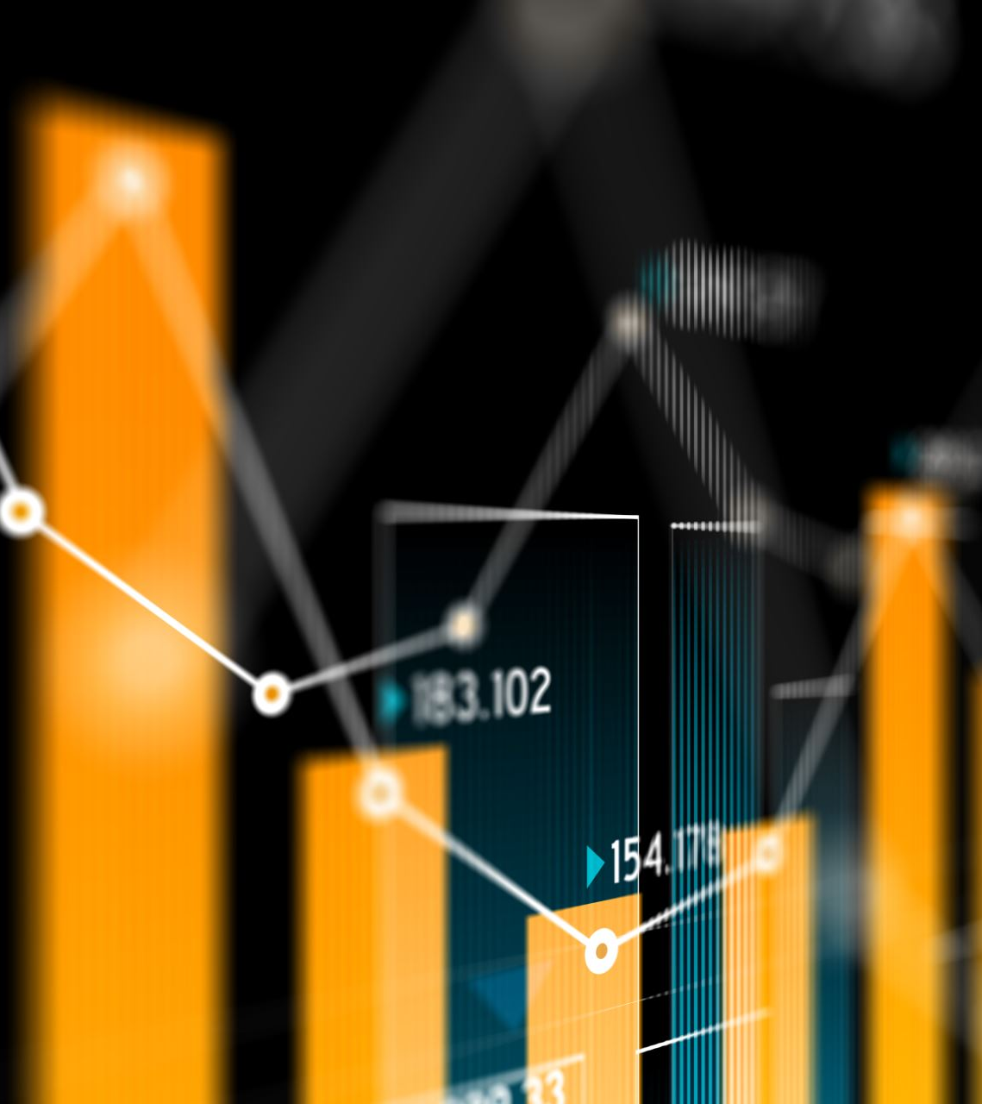
PROPOSED WORK
Agenda:
We want to focus on making patterns simple and easy to understand, not just predictions.
Data and Pipeline:
Dataset: Kaggle Stock Market Dataset (jacksoncrow - https://www.kaggle.com/datasets/jacksoncrow/stock-market-dataset )
Live Data: FinnHub API
External Context: GPT-4 API
Steps:
Clean and preprocess Kaggle dataset.
Train ML models
Collect real-time stock data from FinnHub API.
Run inference with trained ML model → get prediction (Yes/No).
Query GPT-5 API for latest stock-specific analysis/news.
Concatenate ML prediction + GPT-4 insights → feed back to GPT-5 for final analysis.
Display results

Slide 5
EVALUATION
Accuracy & F1-score: How often models predict correctly.
Precision and Recall: How well up/down days are captured.
Combined System: Quality of GPT-4 + model analysis

Slide 6
MILESTONES
Week 1–2: Prepare Kaggle dataset
Week 3–4: Train ML models
Week 5: Integrate FinnHub API for real-time data stock
Week 6: Build inference pipeline (ML Prediction + confidence score)
Week 7: Integrate GPT-4 API for stock/news analysis and combine outputs
Week 8: Final report + Presentation.

Slide 7
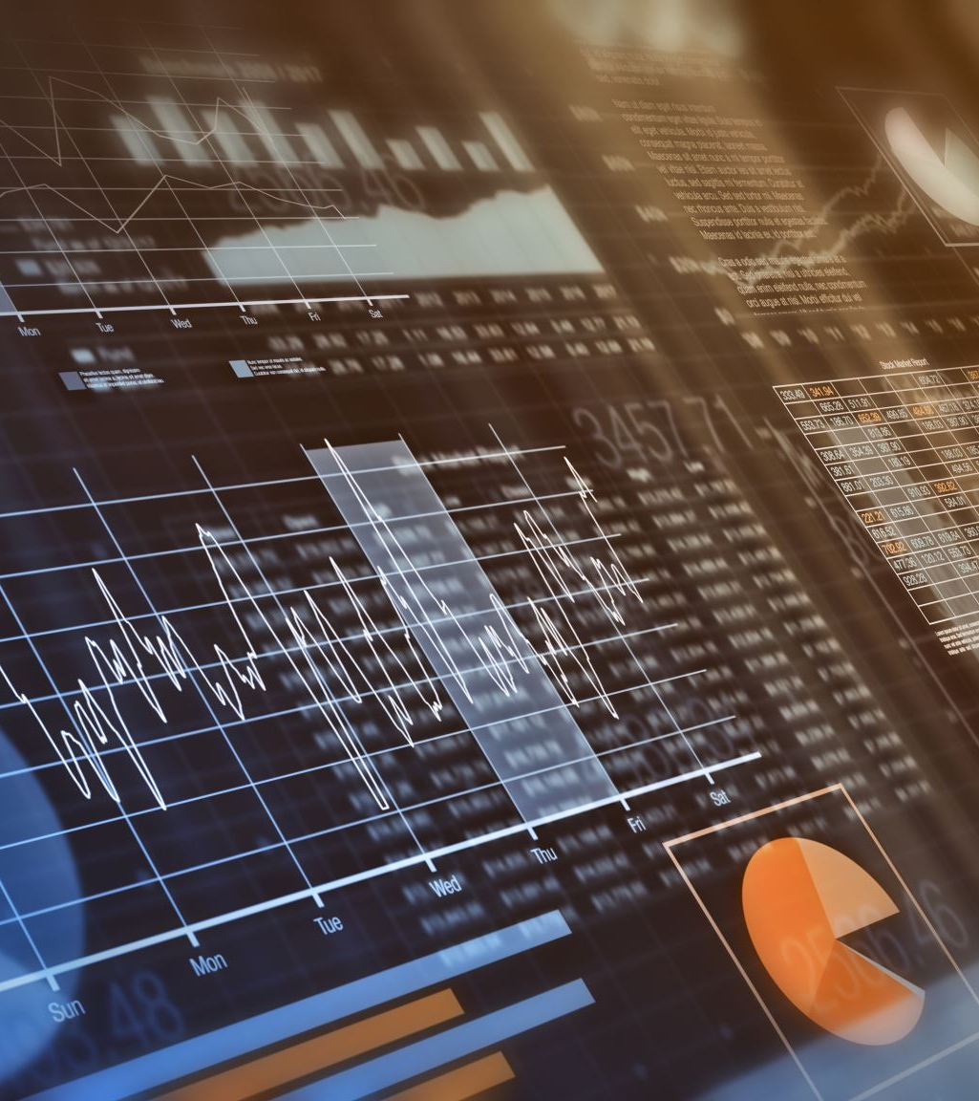
DATA MINING VIEWS
Goes beyond static predictions → adds real-time streaming data.
Aggregates two sources of intelligence:
ML patterns from historical + live prices.
GPT-4 summaries of latest news and analysis.
Produces a final integrated decision.
Combines data mining, machine learning, and AI-driven context into one system.

Slide 8

QUESTIONS

